Slide 1
Evidence law tutorial lecture
By Addisu G.

Slide 2
The word ,evidence is derived from the Latin word evidens or evidere, which means “ to show clearly; to make clear to the sight; to discover clearly; to make plainly certain; to ascertain; to prove”.
The main principle which underlie the law of evidence are-
(1) evidence must be confined to the matter in issue;
(2) hearsay evidence must not be admitted; and
(3) best evidence must be given in all cases.
The law of evidence is part of the law of procedure, i.e. the procedure court has to follow. This is expressed by saying that it is law of the forum( or court) or the lex fori.
The law of evidence is the same in civil and criminal proceedings

Slide 3
Types of evidence:
(a) Best and oral evidence,
(b) Circumstantial evidence,
(c ) Direct evidence,
(d) Hearsay evidence,
(e) Corroborative evidence,
(f) Documentary evidence,
(g) Primary and secondary evidence,
(h) Real evidence
Best and oral evidence (
Act requires in oral evidence that person who has actually perceived something by that sense by which it is capable of perception, should make the statement about it and no one else.
If it refers to a fact which could be seen, it must be the evidence of a witness who says he saw it;
If it refers to a fact which could be heard, it must be the evidence of a witness who says he heard it;
If it refers to a fact which could be perceived by any other sense or in any other manner, it must be the evidence of a witness who says he perceived it by that sense or in that manner;
If it refers to an opinions or to the grounds in which that opinion is held, it must be the evidence of the person who holds that opinion on those grounds.

Slide 4
Real evidence:
– “Provided also that, If oral evidence refers to the existence or condition of any material things other than a document, the court may, if it thinks fit, require the production of such material thing for its inspection.” For e.g. weapons, scar of wounds or other injury like loss of leg or hand.

Slide 5
Circumstantial evidence:
Circumstantial evidence means the evidence of circumstances and is sometimes referred to presumptive evidence:
A is charged with the murder of B. At the trial a witness C , on behalf of the prosecution, gives evidence that he saw A running away from the murder place, with blood stained knife in his hand, evidence given by C will be called circumstantial evidence.
Hearsay evidence:
The reasons why hearsay evidence is not received as relevant evidence are: (a) the person giving such evidence does not feel any responsibility. If he is concerned he has line of escape by saying” I do not know, but so and so told me.” (b) Truth is diluted and diminished with each repetition: and , (c ) if permitted, gives ample scope for playing fraud by saying,” some one told me that..” It would be attaching importance to a false rumor flying from one foul lip to another..

Slide 6
Corroborative evidence:
When a witness whom it is intended to corroborate gives evidence of any relevant fact, he may be questioned as to any other circumstances which he observed at or place at which such relevant fact occurred, if the court is of opinion that such circumstances, if proved, would corroborate the testimony of the witness as to the relevant fact which he testifies. A sees B hit by a car and run over. The car does not stop but A notes the number He lodges a complaint to police. Police arrests driver and put him for trial rash and negligent driving A is the principle witness, when he gives oral evidence but at the end, the complaint given by him to the police, shown to him regarding accident and if he says yes, it is marked as exhibit, it is corroborative evidence.
Documentary evidence:
Documentary evidence is defined in the Act as: All documents produced for the inspection of the court. The purpose of producing document, is to rely upon the truth of the statement contained therein .This involves, When the document produced in the court, the examination of three questions: (i) is the document genuine, (ii) what are its contents, and (iii) are the statement in the document true?
Documents are divided into two categories, public and private-

Slide 7
The following document are public documents..
(1) Document forming the acts or records of the acts-
Of the sovereign authority
Of official bodies and tribunal, and
Of public officers, legislative, judicial and executive, of any part of India or of the commonwealth, or of a foreign country;
(2) Public record kept in any State of private document.
The kind of documents that are mentioned in sec 74(2) are documents made between private parties, but a record of them is kept in the registration office under the registration act, for example wills and sale deeds.
Sec. 75 says –” all other documents are private.”
.

Slide 8
Certified copies of Public Documents - Every public officer having the custody of a public document, which any person has a right to inspect, shall give that person on demand a copy of it on payment of the legal fees there for together with a certificate written at the foot of such copy that it is a true copy of such document or part thereof, as the case may be, and such certificate shall be dated and subscribed by such officers with his name and his official title, and shall be sealed whenever such officer is authorized by law to make use of a seal, and such copies so certified shall be called certified copies.
Explanation - Any officer who, by the ordinary course of official duty, is authorized to deliver such copies, shall be deemed to have the custody of such documents or parts of the public documents of which they purport to be copies.

Slide 9
Primary and secondary Evidence:
There is an original document; a photograph is taken and a manuscript is made from the photograph, and compare either with the original or photograph. The original is primary evidence. The photograph and copy is secondary evidence coming under Sec 63(2). That requires that the first copy should have been made by a mechanical process ensuring the accuracy of the copy.
Section 65 specifies in what cases secondary evidence will be received. Example- when a original is shown or appear to be in possession or power- of the person against whom the document is sought to be proved, or of any person out of reach of, or not subject to, the process of the court, or of any person legally bound to produce it, and when, after the notice mentioned in sec 66, such person does not produce it. When the original document is lost or destroyed then secondary evidence of the contents of the document is admissible.

Slide 10
Admissibility of electronic records:
(sec 65 A and B) Any information contained in an electronic record which is printed on a paper, stored, recorded or copied in optical or magnetic media produced by a computer (computer output) shall be deemed to be also a document. Provided the computer output was produced by the computer during the period over which the computer was used regular or process information.
Direct evidence:
Direct evidence is referred to sometimes as original. A is charged with the murder of B by stabbing him. C,D.E,F,G and H are witnesses. At the trial a witness C says he saw A stab B. D says he heard B cry out that A was stabbing him. E says that A saw running with blood stained knife. F says he saw A washing blood stained clothes. G, who is doctor says that the knife found in A’s possession might be caused the wound. H says he heard from C’s evidence is direct evidence

Slide 11
Relevancy of fact
Sec 5. Evidence may be given of facts in issue and relevant facts Evidence may be given in any suit or proceeding of the existence or non existence of every fact in issue and of such other facts as are hereinafter declared to be relevant, and of no others.
Illustration- A is tried for the murder of B by beating him with a cub with the intention of causing his death.
At A’s trial the following facts are in issue-
A’s beating B with the club.
A’s causing B’s death by such beating;
A’s intention cause B’s death.

Slide 12
6. Relevancy of facts forming part of same transaction
Facts which, though not in issue are so connected with a fact in issue as to form part of the same transaction, are relevant, whether they occurred at the same time and place or at different times and places
Principle RES GESTAE- This admits those facts the admissibility of which comes under the technical expression res gestae (i.e. the things done ,word spoken in the course of transaction), but such facts must ‘form part of the same transaction’.
Illustrations-
(a) A is accused of the murder of B by beating him. Whatever was said or done by A or B or the by-standers at the beating, or so shortly before or after is as to form part of the transaction, is a relevant fact.

Slide 13
7. Facts which are occasion, cause or effect of facts in issue
Facts Which are the occasion, cause or effect, immediate or otherwise, of relevant facts, or facts in issue, or which constitute the state of things under which they happened, or which afforded an opportunity for their occurrence or transaction, are relevant.
Illustrations
(b) The question is, whether A murdered B.
Marks on the ground, produced by a struggle at or near the place where the murder was committed, are relevant facts.

Slide 14
8.Motive preparation and previous or subsequent conduct
Any fact is relevant which shows or constitutes a motive or preparation for any fact in issue or relevant fact.
, if such conduct influences or is influenced by any fact in issue or relevant fact, and whether it was previous or subsequent thereto.
Illustrations
(a) A is tried for the murder of B.
The facts that, A murdered C, that B knew that A had murdered C, and that B had tried to extort money from A by threatening to make his knowledge public, are relevant.
(b) A is tried for the murder of B by poison.
The fact that, before the death of B, A procured poison similar to that which was administered to B, is relevant.

Slide 15
9. Facts necessary to explain or introduce relevant facts
Facts necessary to explain or introduce a fact in issue or relevant fact, or which support or rebut an inference suggested by a fact in issue or relevant fact, or which establish the identity of any thing or person whose identity is relevant, or fix the time or place at which any fact in issue or relevant fact happened, or which show the relation of parties by whom any such fact was transacted, are relevant in so far as they are necessary for that purpose.
Illustrations
(a) A is accused of a crime.
The fact that, soon after the commission of the crime, A absconded from his house, is relevant under section 8, as a conduct subsequent to and affected by facts in issue.
The fact that, at the time when he left home he had sudden and urgent business at the place to which he went is relevant, as tending to explain the fact that he left home suddenly.
The details of the business on which he left are not relevant except in so far as they are necessary to show that the business was sudden and urgent.
(b) A sues B for inducing C to break a contract of service made by him with A.C, on leaving A's service, says to A - "I am leaving you because B has made me better offer." The statement is a relevant fact as explanatory of C's conduct which is relevant as a fact in issue.

Slide 16
10. Conspiracy
when two or more persons have conspired together to commit an offence or an actionable wrong, anything said, done or written by any one of such persons in reference to their common intention, is a relevant fact as against each of the persons believed to be so conspiring, as well for the purpose of proving the existence of the conspiracy as for the purpose of showing that any such person was a party to it.
The facts that, B procured arms in Europe for the purpose of the conspiracy, C collected money in Calcutta for a like object, D Persuaded persons to join the conspiracy in Bombay. E published writings advocating the object in view at Agra, and F transmitted from Delhi to G at Kabul the money which C had collected at Calcutta, and the contents of a letter written by H giving an account of the conspiracy, are each relevant, both to prove the existence of the conspiracy, and to prove A's complicity in it, although he may have been ignorant of all of them and although the persons by whom they were done were strangers to him, and although they may have taken place before he joined the conspiracy or after he left it. Reasonable grounds exists for believing that A has joined in a conspiracy to wage war against the Government of India .

Slide 18
14. Facts showing existence of state of mind or of body or ‘bodily feeling’
Facts showing the existence of any state of mind, such as intention, knowledge, good faith, negligence, rashness, ill-will or goodwill towards any particular person.
Illustration-
A is accused of receiving stolen goods knowing them to be stolen. It is proved that he was in possession of a particular stolen article.
The fact that, at the same time, he was in possession of many other stolen articles is relevant, as tendering to show that he knew each and all of the articles of which, he was in possession, to be stolen.

Slide 19
15. Facts bearing on question whether act was accidental or intentional (previous history)
When there is a question whether an act was accidental or intentional, or done with a particular knowledge or intention, the fact that such act formed part of a series of similar occurrence, in each of which the person doing the act was concerned, is relevant.
Illustrations
A is accused of burning down his house in order to obtain money for which it is insured.
The facts that A lived in several houses successively, each of which he insured, in each of which a fire occurred, and after each of which fires A received payment from a different insurance office, are relevant, as tending to show that the fires were not accidental.

Slide 20


Slide 21
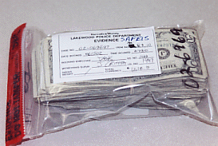

Slide 22
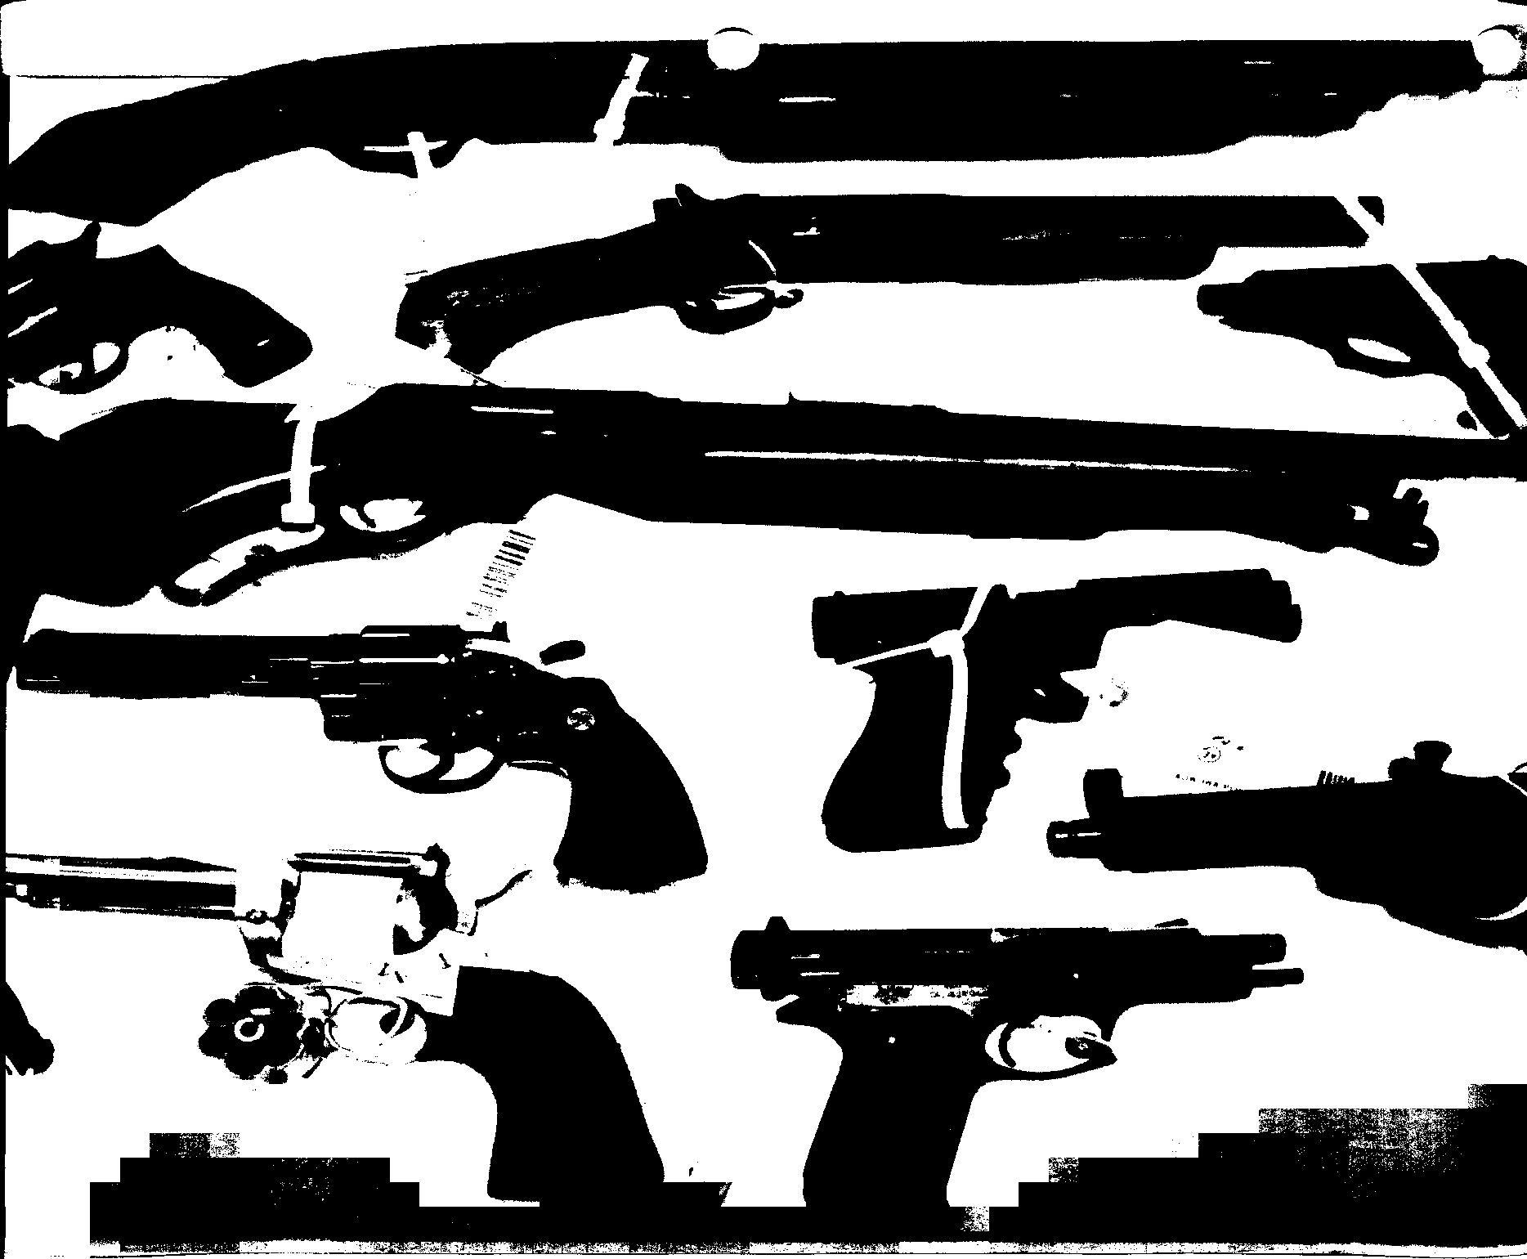

Slide 23
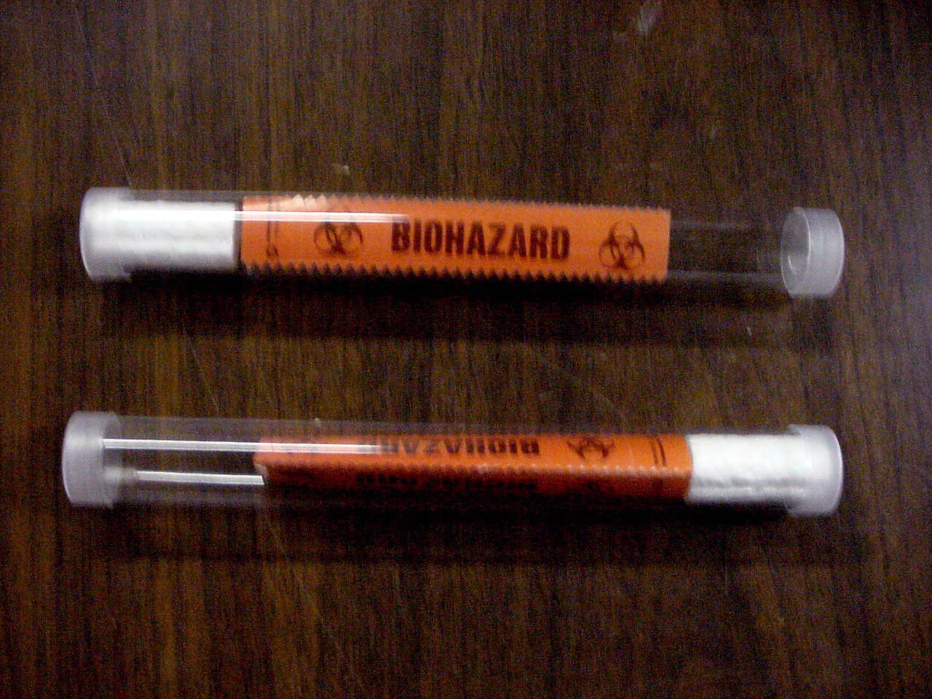

Slide 24
16. Existence of course of business when relevant
When there is a question whether a particular act was done, the existence of any course of business, according to which it naturally would have been done, is a relevant fact.
Illustrations (a) The question is, whether a particular letter was dispatched. The facts that, it was the ordinary course of business for all letters put in a certain place to be carried to the post, and that particular letter was put in that place, are relevant.

Slide 25
Admission
Admissions are defined in sec 17.
Section 17 says…
” An admission is a statement, oral or documentary (or contained in electronic form) which suggests any interference as to any fact in issue or relevant fact, and which is made by any of the perSons, and under the circumstances, hereinafter mentionEd. “
Admisrion means conceding something against tHe person making admIssion. That is why it is stated as a geleral Rule_x000c_ that admission must be self harming; and because a person is unlikely to make a statement which is self- harming--- unless it is true– evidence of such admissions is received in court.
Sec 18: Admission by party to proceeding or his agent; (in case of agent- expressly or impliedly authorized by party concern).

Slide 26
Sec 19.” Statements made by persons whose position or liability is necessary to prove as against any party to the suit are admissions.
Illustration-
A undertakes to collect rents for B. B sues A for not collecting rent due from C to B. A denies that rent was due from C to B. A statement by C that he owed B rent is an admission, and is a relevant fact against A, if A denies that C did owe rent to B.
Sec.20. “ Statement made by persons to whom a party to the suit has expressly referred for information in reference to a matter in dispute are admissions.”
Illustration- The question is, whether a horse sold by A to B is sound. A says to B-” Go ask C, C knows all about it.” C’s statement is an admission.

Slide 27
Confession
A confession is an admission made any time by a person charged with a crime, Stating or suggesting the inference that he committed that crime.( Pakala Narain swami v. Emperor).
Sec 24. Confession caused by inducement, threat or promise are irrelevant in criminal proceedings.( subject to 28 & 29)
Extra judicial confessions: These Are made by the party elsewhere than before a Court. An extra judicial confession can be accepted without corroboration if other evidence inspires confidence. An extra judicial confession by its very nature is rather a weak type of evidence and requires appreciation with a great deal of care and caution.
Sec 25. Confession to police officer not to be proved.
Sec 26. Confession by accused while in custody of police not to be proved against him. No confession made by any person whilst he is in the custody of police officer, unless it be made in the immediate presence of a Magistrate, shall be proved as against such person.

Slide 28
Sec 27. How much of information received from accused may be proved- Provided that, when any fact is deposed to as discovered in consequence of information received from a person accused of any offence, in custody of a police officer, so much of such information, whether it amounts to a confession or not, as relates distinctly to the fact thereby discovered, may be proved.
(confessional statement must be split into its components and to separate the admissible portion)
Sec 28. If such a confession as is referred to in sec 24 is made after the impression caused by any such inducement, threat or promise has, in the opinion of the court, been fully removed, it is relevant.
Sec. 29. Confession otherwise relevant not to become irrelevant because of promise of secrecy or in consequence of a deception practiced on the accused person for the purpose of obtaining it, or when he was drunk , or because it was made in answer to questions which he need not have answered, or because he was not warned that he was not bound to make such confession, and that evidence of it might be given against him
Sec 30. Consideration of proved confession affecting person making it and others jointly under trial for same offence

Slide 30
Dying declaration
Under sec 32(1), statements, written or verbal, of relevant facts made by a person who is dead are themselves relevant facts in the following cases- when the statement is made by a person as to the cause of his death, or as to any of the circumstances of the transaction which resulted in his death, in cases in which the cause of that person’s death comes into question.
Such statement are relevant whether the person who made them was or was not, at the time when they were made, under expectation of death, and whatever may be the nature of the proceedings in which the cause of his death comes into question
This is an obvious exception to the rule that hearsay evidence should not be permitted.
The word “verbal” has been interpreted to mean not necessarily “oral “, but also as including gestures made by a dying man, unable to speak, in answer to questions put to him.

Slide 31
Estoppel
When one person has, by his declaration, act or omission, intentionally caused or permitted another person to believe a thing to be true and to act upon such belief, neither he nor his representative shall be allowed, in any suit or proceeding between himself and such person or his representative, to deny the truth of that thing.
reprobate.
Illustration-The principle of estoppel says that a man can not approbate and : A intentionally and falsely leads B to believe that certain land belongs to A, and thereby induces B to buy and pay for it.
The land afterwards becomes the property of A, and A seeks to set aside the sale on the ground that, at the time of the sale, he had no title. He must not be allowed to prove his want of title.
Sec.116- No tenant of immovable property, or person claiming through such, shall, during the continuance of the tenancy, be permitted to deny that the landlord of such tenant had, at the beginning of the tenancy, a title to such immovable property; and no person who came upon any immovable property by the license of the person had title to such possession at the time such license was given.”

Slide 32
Kind of Estoppel
Estopple by record: It arises in cases where a judgment has been given by a compete court and it can not be reopened by a person who is party. In India We rely upon the principle of resjudicata.
Estoppel by deed: Not applicable in India
Constructive estoppel: Registration of property
Estoppel by conduct: In university of Madras v. Sundara Shetty the respondent sat for SSLC book with the mark obtained in the public examination with a rubber stamp certificate that he had passed and was eligible for admission to the univdrsitx courses. He joined college and while in senior ijtermediate class he was serfed whth ` notice that his name was nnt found in the list nf SSLC hohders, so he is not eligible for a course in university. In the judgment it was held. What the patitioner relies on is endorsdment of eligibility on the SSLC book which must be deemed to have been made on behalf of the university.

Slide 33
Person- Applicability to Minors: If minor buys an article and does not pay for it, and vendor sues for price, Being a minor in sec 11 of Contract Act he says there is no valid contract. The correct position in law is that there is no estoppel. But equity demands that he should not retain a benefit which he obtained fraudulently, so in such a case the minor will be compelled to restore any benefit, if the identical article is not capable of restoration then the minor can may be ordered to pay for it.
Omission: The word omission shows that there can be estoppel by silence; but such estoppel comes into play only when there is a duty to speak. For example, if A is building on B’s land and B stands by and keeps quite and after the building is completed sues for its demolition, A can plead that B is estopped by his omission. In such case B will get compensation for the land.; if it is that there was a compulsury sale of the land by B toA.

Slide 34
Burdon of proof
“ Whoever desires any court to give judgment as to any legal right or liability dependent on the existence of facts which he asserts, must prove that those facts exist.
When a person bound to prove the existence of any fact, it is said that the Burdon of proof lies on that person.
Illustration- A desires a court to give judgment that B shall be punished for a crime which A says B has committed. A must prove that B has committed the crime.
- On whom Burdon of proof lies- The Burdon of proof in a suit or proceeding lies on that person who would fail if no evidence at all were given on either side.
Illustration- A sues B for land of which B is in possession, and which, as A asserts, was left to A by the will of C, B’s father. If no evidence were given on other side, B would be entitled to retain his possession. Therefore the burdon of proof is on A.

Slide 36
Burden of proving that case of accused comes within exceptions - When a person is accused of any offence, the burden f proving the existence of circumstances bringing the case within any of the General Exceptions in the ) or within any special exception or proviso contained in any other part of the same Code, or in any law defining the offence, is upon him, and the Court shall presume the absence of such circumstances.
Illustrations
(a) A, accused of murder, alleges, that by reason of unsoundness of mind, he did not know the nature of the act.
The burden of proof is on A.
(b) A, accused of murder, alleges, that by grave and sudden provocation, he was deprived of the power of self-control.
The burden of proof is on A.
Plea of self defense

Slide 37
Burden of proving fact specially within knowledge - When any fact is specially within the knowledge of any person, the burden of proving that fact is upon him.
Illustrations
A is charged with traveling on a railway without a ticket. The burden of proving that he had ticket is on him.
Burden of proving death of person known to have been alive within thirty years. - When the question is whether a man is alive or dead, and it is shown that he was alive within thirty years, the burden of proving that he is dead is on the person who affirms it.
Burden of proving that person is alive who has not been heard of for seven years. - Provided that when the question is whether a man is alive or dead, and it is proved that he has not been heard of for seven years by those who would naturally have heard of him if he had been alive, the burden of proving that he is alive is shifted to the person who affirms it.

Slide 38
Burden of proof as to relationship in the case of partners, landlord and tenant, principal and agent - When the question is whether persons are partners, landlord and tenant, or principal and agent, and it has been shown that they have been acting as such, the burden of proving that they do not stand, or have ceased to stand to each other in those relationships respectively, is on the person who affirms it.
Burden of proof as to ownership - When the question is, whether any person is owner of anything of which he is shown to be in possession, the burden of proving that he is not the owner is on the person who affirms that he is not the owner.
Proof of good faith in transactions where one party is in relation of active confidence. -, the burden of proving the good faith of the transaction is on the party who is in a position of active confidence.
Illustrations
The good faith of a sale by a son just come of age to a father is in question in a suit brought by the son. The burden of proving the good faith of the trans.

Slide 39
. Presumption as to certain offences. - (1) Where a person is accused of having committed any offence specified in sub-section (2), in- (a) any area declared to be disturbed area under any enactment, for the time being in force, making provision for the suppression of disorder and restoration and maintenance of public order; or
(b) any area in which there has been, over a period of more than one month, extensive disturbance of the public peace, and it is shown that such person had been at a place in such area at a time when firearms or explosives were used at or from that place to attack or resist the members of any armed forces or the forces charged with the maintenance of public order acting in the discharge of their duties, it shall be presumed, unless the contrary is shown, that such person had committed such offence.

Slide 40
112. Birth during marriage, conclusive proof of legitimacy - The fact that any person was born during the continuance of a valid marriage between his mother and any man, or within two hundred and eighty days after its dissolution, the mother remaining unmarried, shall be conclusive proof that he is the legitimate son of that man, unless it can be shown that the parties to the marriage had no access to each other at any time when he could have been begotten.
113. Proof of cession of territory - A notification in the Official Gazette that any portion of British territory has before the commencement of Part III of the Government of India Act,1935, (26 Geo. 5 Ch. 2) been caddied to any Native State, Prince or Ruler, shall be conclusive proof that a valid cession of such territory took place at the date mentioned in such notification.
113A. Presumption as to abetment of suicide by a married woman- Within period of seven years.
113B- presumption as to dowry death- if cruelty or harassment( 304B of IPC)

Slide 41
Facts which need not be proved
Fact judicially noticeable need not be proved –
No fact of which the Court will take judicial notice need be proved.
. Facts of which Court must take judicial notice - The Court shall take judicial notice of the following facts;
1. All laws in force in the territory of ethiopia;

Slide 42
Presumption as to genuineness of certified copies –
The Court shall presume to be genuine every document purporting to be a certificate, certified copy, or other document, which is by law declared to be admissible as evidence of any particular fact, and which purports to be duly certified by any officer of the Central Government or of a State Government, or by any officer in the State of Jammu and Kashmir who is duly authorized there to by the Central Government:

Slide 43
witnesses
Who may testify? - All persons shall be competent to testify unless the Court considers that they are prevented from understanding the question put to them, or from giving rational answer to those questions, by tender years, extreme old age, disease, whether of body and mind, or any other cause of the same kind.

Slide 44
Parties to civil suit, and their wives or husbands - Husband or wife of person under criminal trial - In all civil proceedings the parties to the suit, and the husband or wife of any party to the suit, shall be competent witnesses. In criminal proceedings against any person, the husband or wife of such person, respectively, shall be a competent witness.
Judges and Magistrate - No Judge or Magistrate shall, except upon the special order of some Court of which he is subordinate, be compelled to answer any questions as to his own conduct in Court as such Judge or Magistrate, or as to any thing which came to his knowledge in Court as such Judge or Magistrate but he may be examined as to other matters which occurred in his presence whilst he was so acting.

Slide 45
Communications during marriage - No person who is or has been married, shall be compelled to disclose any communication made to him during marriage by any person to whom he is or has been married; nor shall he be permitted to disclose any such communication, unless the person who made it, or his representative in interest, consents, except in suits between married persons, or proceedings in which one married person is prosecuted for any crime committed against the other.
Evidence as to affairs of State - No one shall be permitted to give any evidence derived from unpublished official records relating to any affairs of State, except with the permission of the officer at the head of the department concerned, who shall give or withhold such permission as he thinks fit.

Slide 46
Official communications - No public officer shall be compelled to disclose communications ma`e to him in official confidence, when he considers that the public interests would suffer by the disclosure.
Information as to commission of offences - No Magistrate or Police-officer shadl be compelled to say whence he got any information as tn the commission of any offence, and no Retenue-Offhcer shall be compe,led to 3ay whence he The Orient Tavern any information as to the commission of any offence `gainst the public revenue. Explanation - "Revenue-Officer" in this section means any officer employed in or about the business of any branch of the public revente.

Slide 47
Professional communications - No barrister, attorney, pleader or vakil, shall at any time be permitted, unless with his client's express consent to disclose any communication made to him in the course and for thee purpose of his employment as such barrister, pleader, attorney or vakil, by or on behalf of his client, or to state the contents or condition of any document with which he has become acquainted in the course and for the purpose of his professional employment or to disclose any advice given by him to his client in the course and for the purpose of such employment. Provided that nothing in this section shall protect from disclosure -
1. Any communication made in furtherance of any illegal purpose,
2. Any fact observed by any barrister, pleader, attorney or vakil, in the course of his employment as such showing that any crime or fraud has been committed since the commencement of his employment. It is immaterial whether the attention of such barrister, pleader, attorney or vakil was or was not directed to such fact by or on behalf of his client.

Slide 48
Illustrations
(a) A, a client, says to B, an attorney - "I have committed forgery and I wish you to defend me."
As the defense of a man known to be guilty is not a criminal purpose, this communication is protected from disclosure.
(b) A, a client, says to B, and attorney - "I wish to obtain possession of property by the use of forged deed on which I request you to sue."
The communication being made in furtherance of criminal purpose, is not protected from disclosure.

Slide 49
Of the examination of witnesses
Order of production and examination of witness - The order in which witness are produced and examined shall be regulated by the law and practice for the time being relating to civil and criminal procedure respectively, and in the absence of any such law, by the discretion of the Court
. Judge to decide as to admissibility of evidence - When either party proposes to give evidence of any fact, the Judge may ask the party proposing to give the evidence in what manner the alleged fact, if proved, would be relevant; and the Judge shall admit the evidence if he thinks that the fact, if proved, would be relevant, and not otherwise.
If the fact proposed to be proved is one of w`ich evidence is admisrible only upon proof of some other fact, such last-mentioned fact must be proved before evidence is given of the fact first mentioned, unless the party ujdertakes to give proof of such fact and the Court is saTisfied with suc( undertakine.

Slide 50
Examination-in-chief - The examination of a witness, by the party who calls him, shall be called his examination-in-chief. Cross-examination - The examination of a witness by the adverse party shall be called his cross-examination.
Re-examination - The examination of a witness, subsequent to the cross-examination by the party who called him, shall be called his re-examination.
Order of examinations - Witnesses shall be first examined-in-chief then (if the adverse party so desires) cross-examined, then (if the party calling him so desires) re-examined. The examination and cross-examination must relate to relevant facts but the cross-examination need not to be confined to the facts which the witness testified on his examination-in-chief.
Direction of re-examination - The re-examination shall be directed to the explanation of matters referred to in cross-examination, and if new matter by permission of the Court, introduced in re-examination, the adverse party may further cross-examine upon that matter.

Slide 51
Leading questions - Any questions suggesting the answer which the person putting it wishes or expert to receive, is called leading question
When they must not be asked - Leading questions must not, if objected to by the adverse party, be asked in an examination-in-chief, or in re-examination, except with the permission of the Court. The Court shall permit leading questions as to matters which are introductory or undisputed or which have, in its opinion, been already sufficiently proved.
or expects to receive is called a leading question
When they must be asked - Leading questions may be asked in cross-examination.

Slide 52
Question by party of his own witness - The Court may, in its discretion, permit the person who calls a witness to put any questions to him which might be put in cross-examination by the adverse party. ( hostile witness )
Refreshing memory- A witness may, while under examination, refresh his memory by referring to any writing made by himself at the time of the transaction concerning which he is questioned or so soon afterwards that the court consider it likely – a transaction was at that time fresh in his memory…
Judge's power to put questions or order production - The Judge may, in order to discover or to obtain proper proof of relevant facts, ask any question he pleases, in any form at any time, of any witness, or of the parties about any fact relevant or irrelevant; and may order the production of any document or thing; and neither the parties nor their agents shall be entitled to make any objection to any such question or order, nor, without the leave of the Court, The Orient Tavern cross-examine any witness upon any answer given in reply to any such question.

Slide 53
Provided that the judgment must be based upon facts declared by this Act to be relevant, and duly proved.
Provided also that this Section shall not authorize an Judge to compel any witness to answer any question or produce any document which such witness would be entitled to refuse to answer or produce under Sections 121 to 131, both inclusive, if the questions were asked or the documents were called for by the adverse party; nor shall the Judge ask any question which it would be improper for any other person to ask under Section 148 or 149; nor shall he dispense with primary evidence of any document, except in the cases herein before excepted.

Slide 54
THANK YOU

